Slide 1
GLOBAL YOUTUBE DATASET
BY VANMATHI K

Slide 2
CONTENT
COUNT OF YOUTUBERS
SUM OF SUBSCRIBERS
YOUTUBERS BY COUNTRY
UPLOADS BY CATEGORY
SUBSCRIBERS BY COUNTRY
SUBSCRIBERS BY CATEGORY
HIGH AND LOW MONTHLY EARNINGS BY CHANNEL TYPE
HIGH AND LOW YEARLY EARNINGS BY CHANNEL TYPE
FIVE TOP MOST VIEWS BY CATEGORY
FIVE LEAST VIEWS BY CATEGORY
LAST 30 DAYS SUBSCRIBES BY CHANNEL TYPE
YOUTUBER BY YEAR

Slide 3
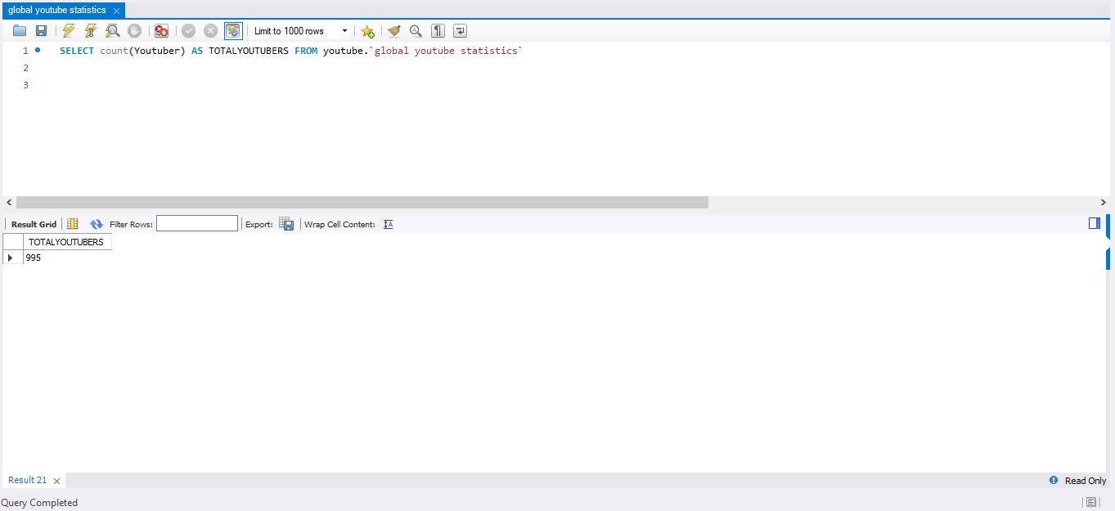
COUNT OF YOUTUBERS

Slide 4
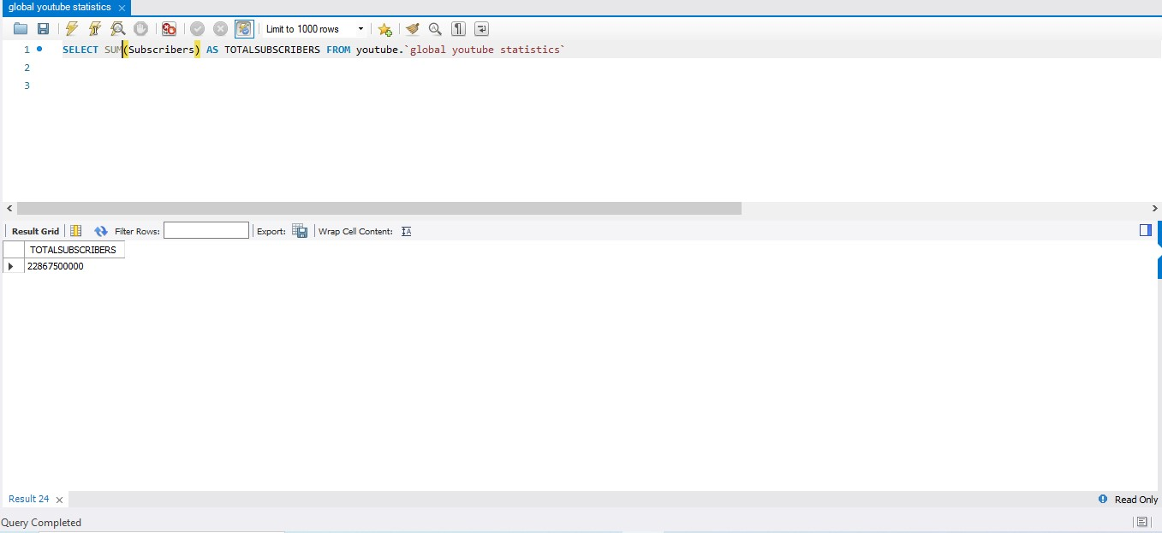
SUM OF SUBSCRIBERS

Slide 5
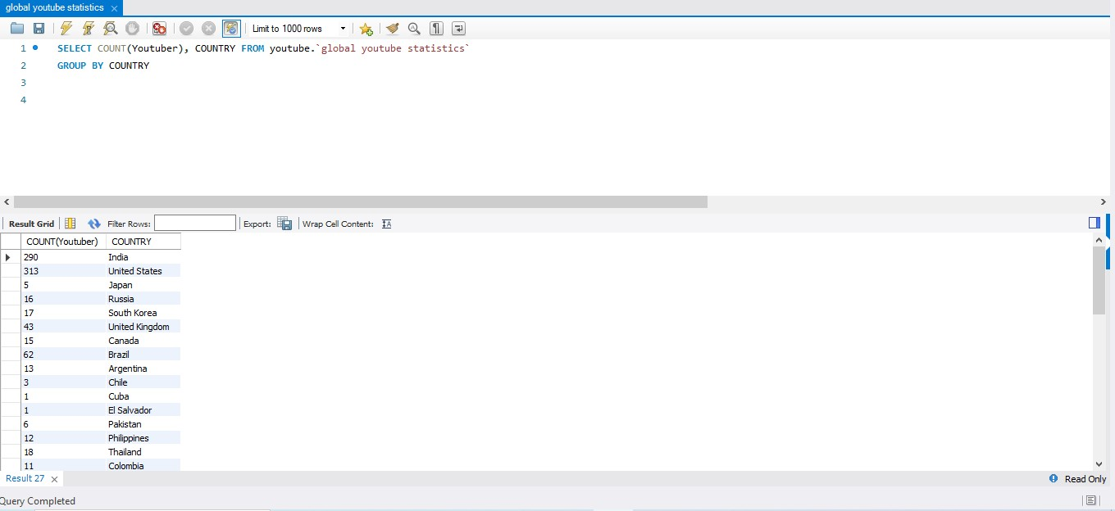
YOUTUBERS BY COUNTRY

Slide 6
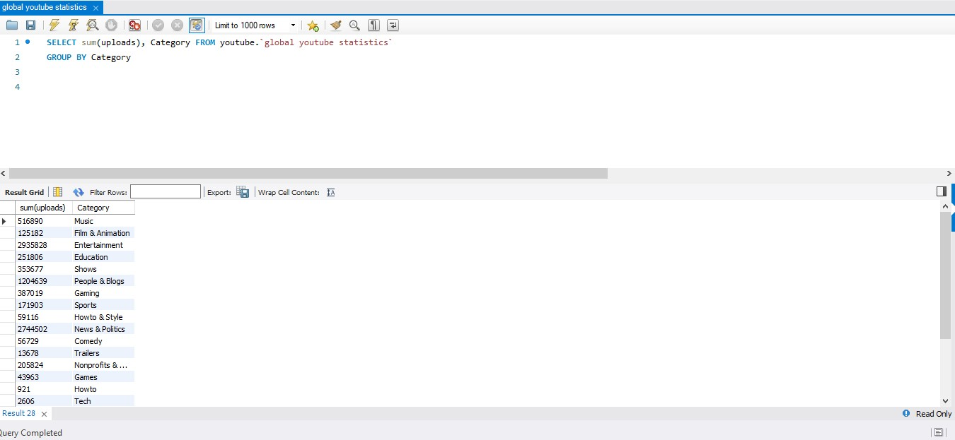
UPLOADS BY CATEGORY

Slide 7
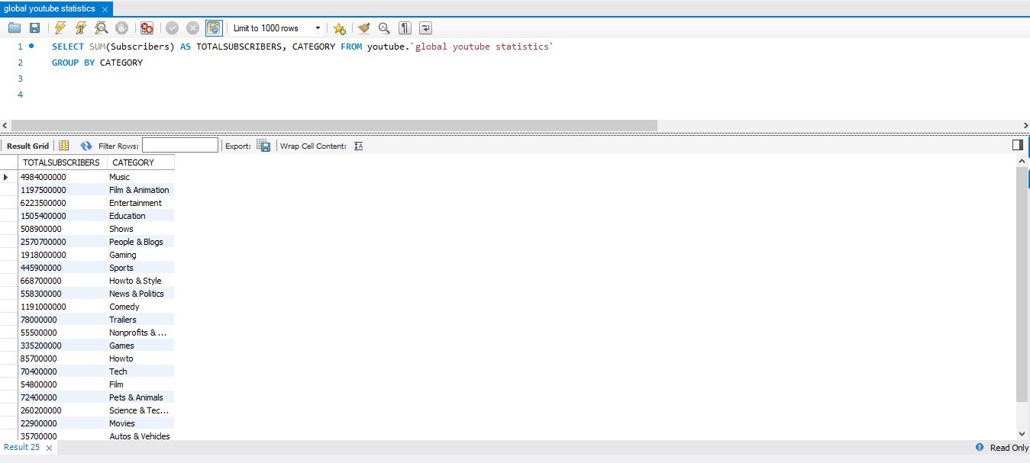
SUBSCRIBERS BY CATEGORY

Slide 8
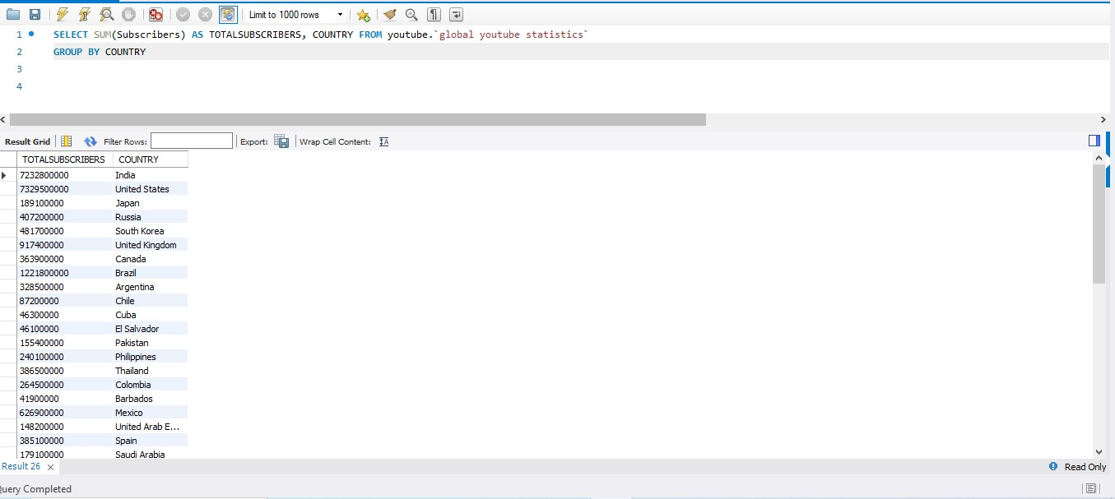
SUBSCRIBERS BY COUNTRY

Slide 9
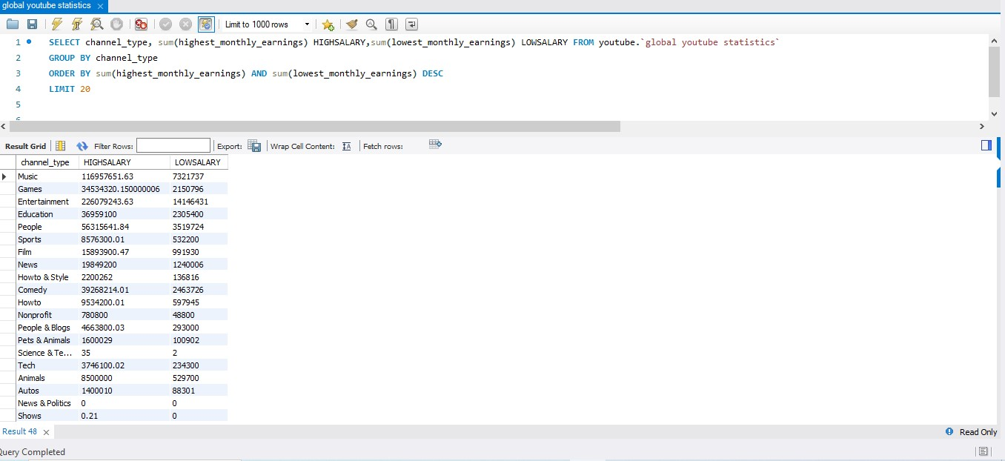
HIGH AND LOW MONTHLY EARNINGS BY CHANNEL TYPE

Slide 10
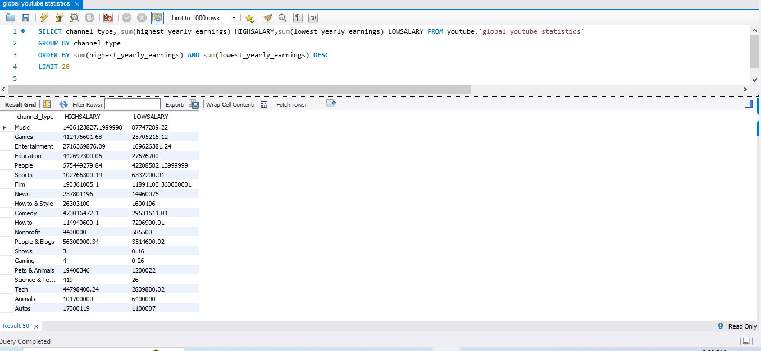
HIGH AND LOW YEARLY EARNINGS BY CHANNEL TYPE

Slide 11
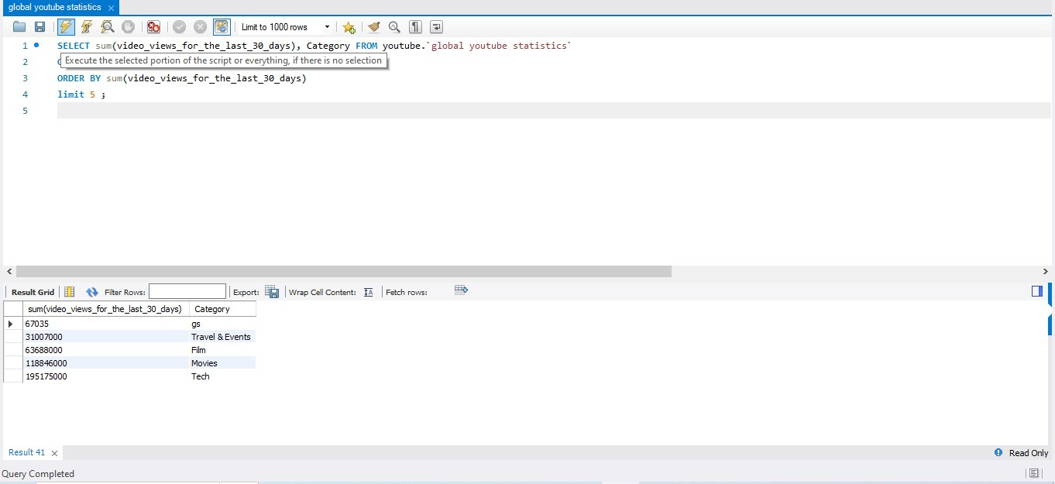
FIVE TOP MOST VIEWS BY CATEGORY

Slide 12
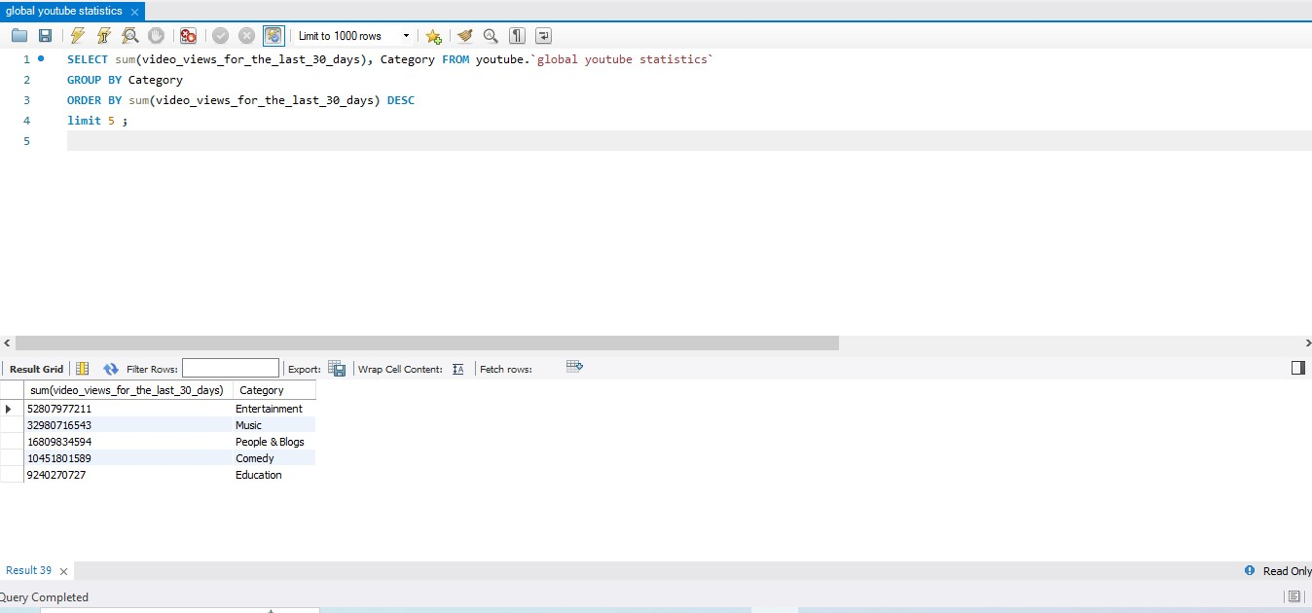
FIVE TOP MOST VIEWS BY CATEGORY

Slide 13
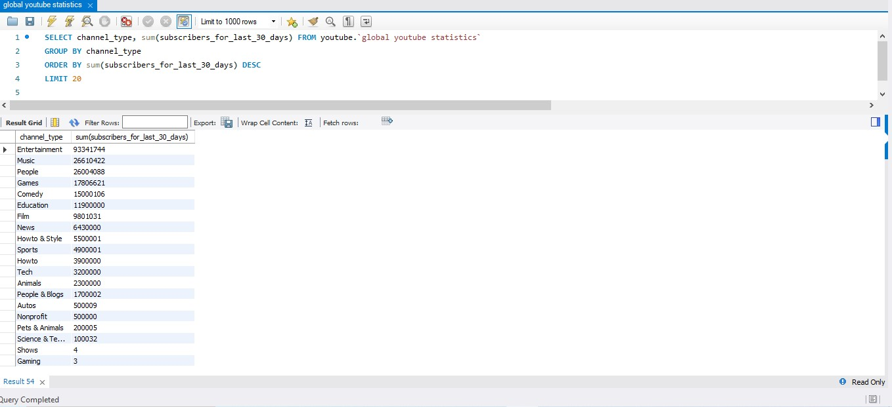
LAST 30 DAYS SUBSCRIBES BY CHANNEL TYPE

Slide 14
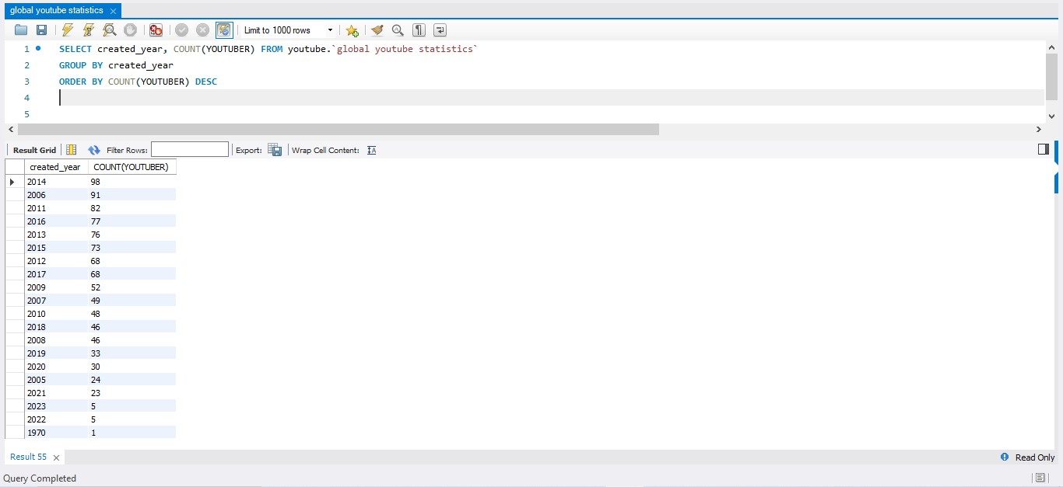
YOUTUBER BY YEAR

Slide 15
THANK YOU

